Slide 1
Intro to Sencha Ext JS 4
JavaScript Framework for Rich Apps in Every Browser
Maura Wilder maura@devpartners.com
Joan Wortman joan.wortman@gmail.com

Slide 2
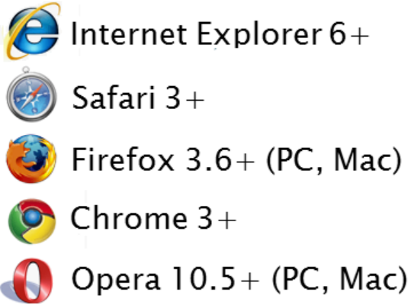
Ext JS 4
Mature library
  Extensible architecture
    Extend (inheritance)
    Mixins (multiple inheritence/traits)
    Plugin
  Theme builders
  Data support
True cross-browser support

Slide 3
Widgets
Components
Data Store
Grid
Charts
Layout Management
More…
Examples
http://dev.sencha.com/deploy/ext-4.0.0/examples/desktop/desktop.html

Slide 4
Components (class system)
Component
Observable
Panel
Tab Panel
Menu
Window
resizeable
draggable

Slide 5
Mixins (multiple-traits)
01.Ext.define('Ext.Window', {
02. extend: 'Ext.Panel',
03. requires: 'Ext.Tool',
04. mixins: {
05. draggable: 'Ext.util.Draggable'
06. },
07.
08. config: {
09. title: "Window Title"
10. }
11.});

Slide 6
Data Package
Models and Stores to define data format
DataReaders and DataWriters to populate, and update data
Local (in-page) and Remote (ajax) data access
Databinding with common widgets (grid/tree/combobox)
Built in filtering, sorting, grouping
Supports client-side MVC
http://bit.ly/k19wuS
http://bit.ly/iUfT39

Slide 7
Grids
Plugible data stores: array, json, xml, static (ajax, rest), dynamic (writable)
Configurable features: grouping, paging, filtering, progress bar, sorting, cell and row editing, locking, searching, buffered scrolling…
Customizable views
Plugin capabilities
(show examples)

Slide 8
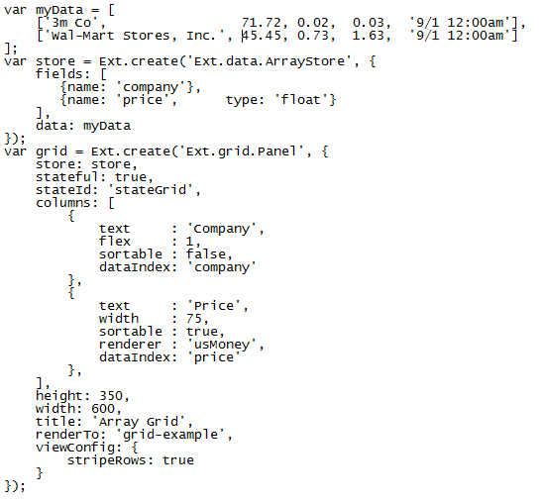
Grid Code

Slide 9
Charts
Pure javascript charting package
Extends the Ext.draw package
  Works with SVG and VML, automatically using the best engine it can find on each browser
Full featured chart library
  Pie, bar, stacked, line, etc
  Scatter plots, gauges, live update, radar charts
Works using the same data sets as Grids
  Define the axes
  Define the series
Example:
http://dev.sencha.com/deploy/ext-4.0.0/examples/charts/FormDashboard.html

Slide 10
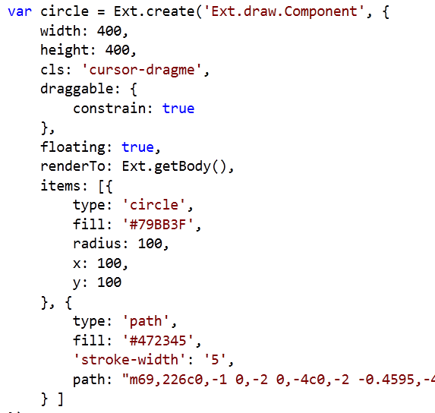
Draw
Example

Slide 11
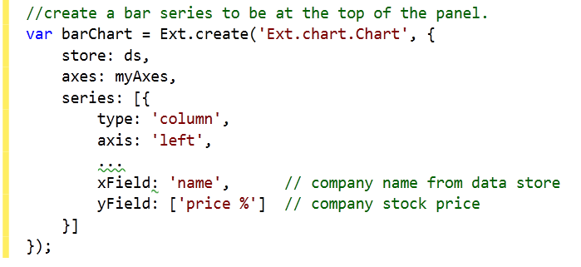
Charts example/code

Slide 12
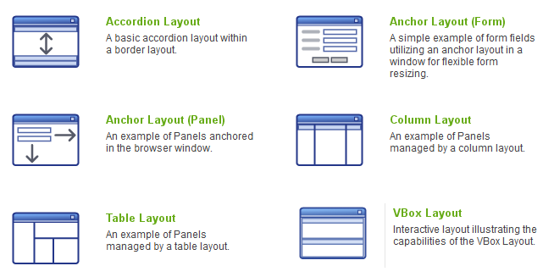
Layout Management

Slide 13
Column layout example
http://dev.sencha.com/deploy/ext-4.0.0/examples/layout/column.html

Slide 14
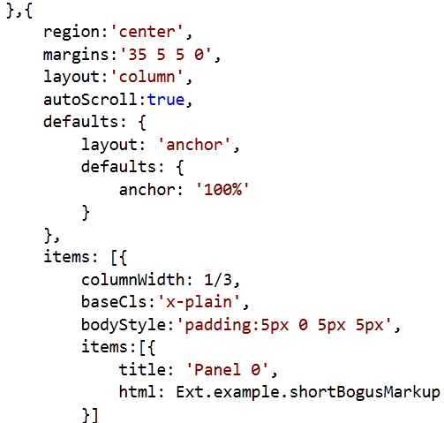
Column
Layout
Code

Slide 15
What Else?
Dom Manipulation CSS selector query Component rendering Templates Event Management Custom Events Remote functions Forms Animation Keyboard support | Client side MVC Z-index management Widgets Trees Combo boxes Progress indicators Buttons Menus Dialogs …

Slide 16
More Sencha Products…
Sencha Touch
  Mobile application developer
Sencha Designer
  Wysiwyg design tool
Sencha Animator
  CSS 3 Animations
Sencha GWT
  Ext controls available with GWT
  Geared toward Java developers

Slide 17
Questions???
Maura Wilder maura@devpartners.com
Joan Wortman joan.wortman@gmail.com

