Slide 1


Intro to Blockchain-Focused Software Development
Maura Wilder, VP of Engineering
Notes:
Description
Cryptocurrency, smart contracts, web3, and blockchain may seem scary, but they’re just terms in a new domain with new programming languages and frameworks. In the ever-changing world of software, developers are used to that. Come and hear about the various ways you can build apps on or for blockchains.
After an introduction to the domain and some core terminology, we'll step through code demos including:
- a Solidity smart contract, basic code running on a blockchain's virtual machine
- a basic web3 integration which will include executing functions on the smart contract
Attendees should come away with a good overview of what's involved in blockchain development.

Slide 2
About me
VP of Engineering at Metallicus, a fintech in the blockchain space
Engineering at Circle & Poloniex, cryptocurrency exchange
Engineer #2 at DraftKings, 24x7 fantasy sports
And then some…
X, Telegram: @squdgy
Email: maura@metallicus.com, maura@devpartners.com

Slide 3
“I love this stuff - bitcoin, ethereum, blockchain technology - and what the future holds.”
Abigail Johnson, Chairman and CEO at Fidelity Investments
Notes:
Blockchain is out there. Lots of companies, including banks, investment companies and other fintechs are out there. Despite some of the issues in the industry in the last 24 months, such as the collapse of FTX, the industry is moving forward. I’m going to show you how you can be involved at a developer level if it’s something that interests you. I like this quote because it’s representative of what a lot of execs are thinking. Let’s go.

Slide 4
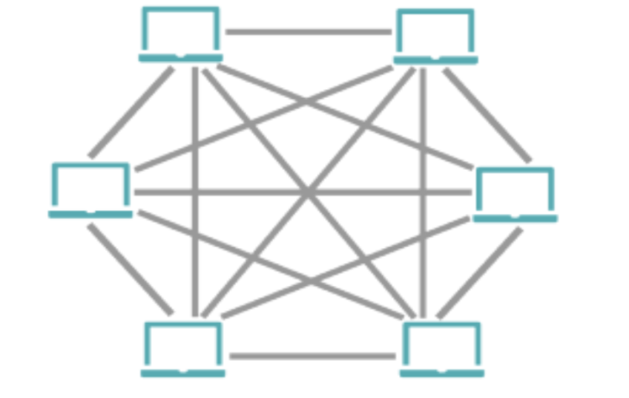
Concepts
Blockchain
Cryptocurrency
Smart Contract
Web3
Notes:
I think an important thing to understand first is what a blockchain network is. I’ve drawn this simplistic image of a lot of computers networked together. That’s because a blockchain network, commonly shortened to blockchain, is composed of compute nodes which operate a peer to peer network and store state on their own local storage. That storage is often referred to as a digital ledger. Blockchains use heavy use of public/private key cryptography, the reason the term “crypto” is used so heavily in the space. We won’t really delve into that here.
The “killer app” which really pushed blockchain into widespread use is a cryptocurrency which you have probably heard of, bitcoin. Bitcoin is a digital store of value where the properties of “money” are controlled and secured by software - holding, spending, money supply, inability to double-spend etc. We won’t go into great detail here, but bitcoin is still going strong 15 years after it was first introduced, and there are thousands of other “cryptos” out there..
A smart contract is a fancy way of describing an application which runs on the virtual machine present on many blockchains. The term “contract” is intentional and comes from a legal sense, in that you are able to enforce pre-defined behavior via code. Most of what we talk about will be smart contract programming.
Web3 is a nebulous term, described differently by different people, but I describe it as web applications which interact smart contracts. In practice Web3 applications are usually hybrid applications using traditional backends, but having some feature or features which use the blockchain. We’ll briefly show an example of a simple Web3 application.

Slide 5
What is a Smart Contract?
Executes “on-chain” (EVM, WASM etc.)
State stored in blocks
Supports inheritance
Can call other contracts
Languages: Solidity, Vyper, Typescript, C++, Rust etc.
Notes:
Now let’s talk about smart contracts. These are the programs that run “on-chain”. The programming language for a chain depends on the chain and what languages are supported for that chain. For instance Ethereum’s most popular language is known as Solidity. It’s similar to javascript. It compiles down to Ethereum Byte Code. But it’s not the only one. Vyper is also supported. It’s pythonic.
The EVM and Solidity are so popular in the blockchain world, that many other chains provide EVM compatibility. Code written for the Ethereum blockchain will also compile and work on vms on these other compatible blockchains. Metal Blockchain contains an EVM compatible chain. There are also a lot of developer tools and libraries out there that make getting started writing smart contracts very easy.

Slide 6
A Basic Smart Contract for a Cryptocurrency
// contracts/mycoin.sol
pragma solidity ^0.8.0;
import "@openzeppelin/contracts/token/ERC20/ERC20.sol";
contract MyCoin is ERC20 {
constructor(uint256 initialSupply) ERC20("MyCoin", "MCC") {
_mint(msg.sender, initialSupply);
}
}
Notes:
This is a really simple solidity smart contract, which uses another implementation from OpenZeppelin.
Using Open Zeppelin is a quick and easy way to create smart contracts that meet particular EVM guidelines.
This particular one is a token contract for a token called “MCC”. When you instantiate this you tell it the initial supply. The underlying implementation provides all of the other necessary functionality. You can review the Open Zeppelin docs for more info.

Slide 7
Smart Contract Demo
https://github.com/squdgy/hello_smart_contract
Notes:
Show project
Show contract code
Show how to unit test
Show how to deploy
Show how to execute read + write
Show on live environment via block explorer

Slide 8
Web3 Demo
https://bridge-frontend-steel.vercel.app/
Notes:
Show project
Show contract code
Show how to unit test
Show how to deploy
Show how to execute read + write
Show on live environment via block explorer

Slide 9
References
https://ethereum.org/en/developers/docs/
https://docs.openzeppelin.com/
https://hardhat.org/
https://remix.ethereum.org/
https://github.com/squdgy/hello_smart_contract
https://squdgy.wordpress.com/ (for slides)
Notes:
About talk - feel free to stop me and ask questions.

Slide 10
